Slide 1
Occupancy Modeling CSP4141
Introduction to Single Season-
Single Species Occupancy Model
Tuesday, May 22nd, 2018
National Conservation Training Center Course
May 21st - 25th, 2018
Columbia River Fisheries Program Office

Slide 2

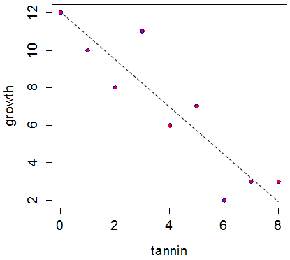
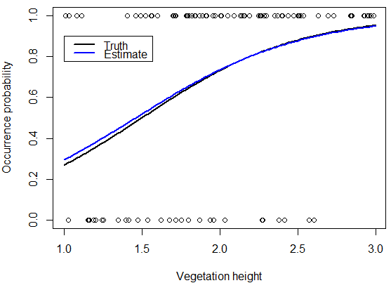
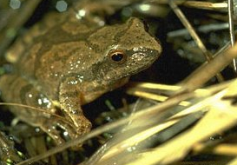
Unmarked Occupancy Models
Hierarchical models
Hierarchical extension to a Bernoulli GLM or logistic regression

Slide 3
Single Season Occupancy
Hard to observe a true absence (or the true count statistic, ecological state, etc.)
If detected = Species presence is certain.
If not detected = Species is either:
Truly absent
or…
Present but missed

Slide 4
Single-season Occupancy
The basic single –season occupancy model, has 2 processes that determine whether the target species is detected at the site.
1)
the site i may be occupied by the species with probability Ψ_{I}
the site may be unoccupied with probability 1- Ψ_{I}

Slide 5
Single-season Occupancy
The basic single –season occupancy model, has 2 stochastic processes that determine whether the target species is detected at the site.
2)
If the site i is occupied by the species, there is some probability (p_{ij}) of detecting of detecting it during each survey j
If the site is unoccupied, then we cannot detect the species.

Slide 6
Single Species-Single Season (SS-SS) …When to use?
If you have detection-nondetection data, you can fit a logistic regression to the occurrence state, under the assumption that we observe it without error.
Since we’ve already said that this is a highly unlikely situation….
You should use the data in an occupancy framework (i.e., calculate both occupancy probability and detection probability).

Slide 7
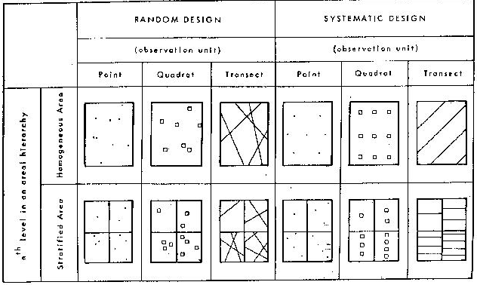
SS-SS…When to use?
Data of species of interest collected according to some well thought-out sampling design in which there are repeat surveys (T distinct occasions in time)….
and the data meet the main assumptions for occupancy modeling.

Slide 8
Single Season- Single Species Model
Main assumptions of the site-occupancy model:
Closure Assumption
No False Positive Errors
Independence of Detection
Homogeneity of Detection at the M Sites
Parametric Assumptions

Slide 9
Single Season- Single Species Model
Main assumptions of the site-occupancy model:
Closure Assumption
No False Positive Errors
Independence of Detection
Homogeneity of Detection at the M Sites
Parametric Assumptions

Slide 10
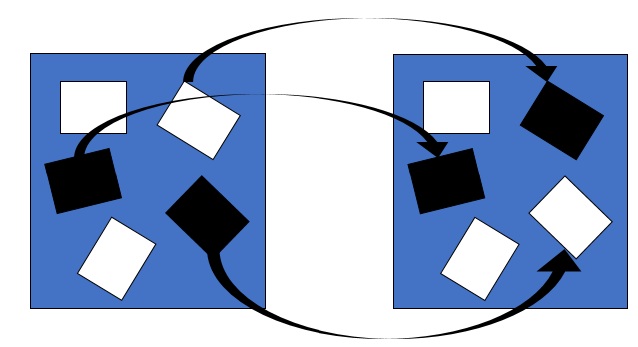
Single Season- Single Species Model
Main assumptions of the site-occupancy model:
Closure Assumption
-occurrence state z_{i} doesn’t change over the course of the study
-“short” time period

Slide 11
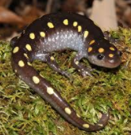



Single Season- Single Species Model
Closure Assumption
What if….
Mole salamanders & surveys begin in NY in early spring?
Salmon & surveys begin mid-summer in Kenai River?
…
What about for semivoltine or multivoltine insect species?

Slide 12
Single Season- Single Species Model
Main assumptions of the site-occupancy model:
Closure Assumption
No False Positive Errors
Independence of Detection
Homogeneity of Detection at the M Sites
Parametric Assumptions

Slide 13
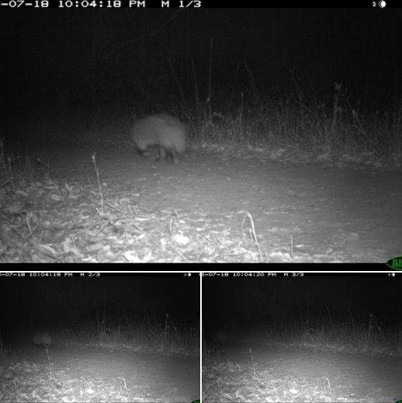
Single Season- Single Species Model
No False Positive Errors
Camera trap photos…
Bird/amphibian call surveys…
Aerial surveys…

Slide 14
Single Season- Single Species Model
Main assumptions of the site-occupancy model:
No False Positive Errors
-Important assumption
-Violation can lead to bias in occ estimator
-Usually, treat doubtful ID as a 0

Slide 15
Single Season- Single Species Model
Main assumptions of the site-occupancy model:
Closure Assumption
No False Positive Errors
Independence of Detection
Homogeneity of Detection at the M Sites
Parametric Assumptions

Slide 16
Single Season- Single Species Model
Main assumptions of the site-occupancy model:
3. Independence of Detection
- What if your sampling units are “close” together (in proximity)?
- What if the observer “knows” where to look after the 1st survey?

Slide 17
Single Season- Single Species Model
Main assumptions of the site-occupancy model:
Closure Assumption
No False Positive Errors
Independence of Detection
Homogeneity of Detection at the M Sites
Parametric Assumptions

Slide 18
Single Season- Single Species Model
Main assumptions of the site-occupancy model:
4. Homogeneity of Detection at the M Sites
- Detection heterogeneity → underestimates of occ parameter
- Must account for in model

Slide 19
Single Season- Single Species Model
Homogeneity of Detection at the M Sites
Covariate modeling
RN model adoption
N-mixture models (count data)
Model latent structure (~Bayesian MCMC analysis)

Slide 20
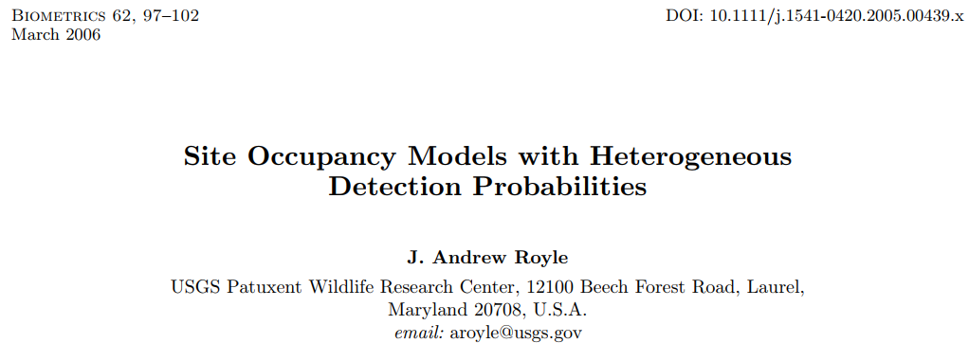
Single Season- Single Species Model
Homogeneity of Detection at the M Sites
RN model (Royle-Nichols 2003)
-heterogeneous detection probabilities by considering several common classes of mixture distributions for p (including continuous and discrete mixtures)

Slide 21
Single Season- Single Species Model
Main assumptions of the site-occupancy model:
Closure Assumption
No False Positive Errors
Independence of Detection
Homogeneity of Detection at the M Sites
Parametric Assumptions

Slide 22
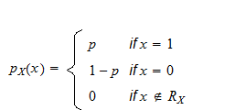
Single Season- Single Species Model
Main assumptions of the site-occupancy model:
5. Parametric Assumptions
- assume two Bernoulli’s are reasonable

Slide 23
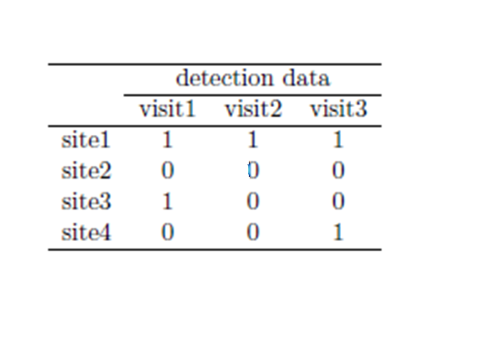
Unmarked data structure- SS Model
Sample units are called ‘sites’
There are multiple ‘observations’ at each site
If using site-occupancy model, we make multiple ‘visits’ to each site
If using a double-observer framework, then we have 2 observations per site

Slide 24
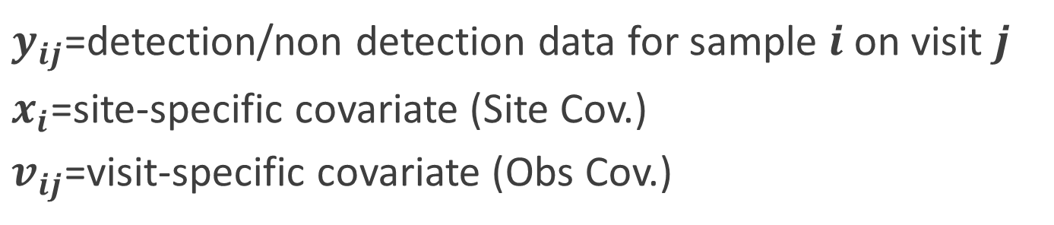
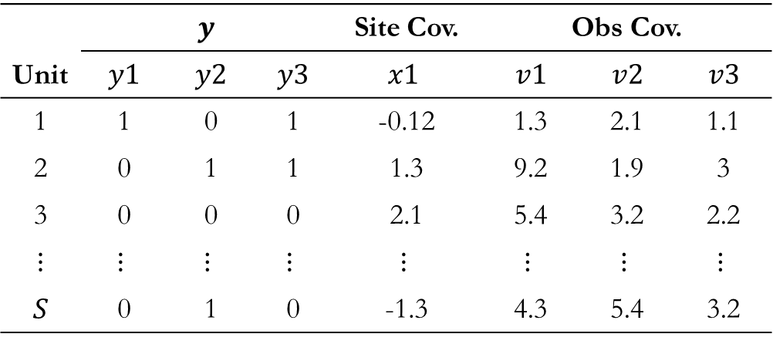
Unmarked Data Structure- SS Model
$y_{ij}$=detection/non detection data for sample $i$on visit $j$
$x_{i}$=site-specific covariate (Site Cov.)
$v_{ij}$=visit-specific covariate (Obs Cov.)
Unit | $$y$$ |  |  | Site Cov. | Obs Cov.
 | $$y1$$ | $$y2$$ | $$y3$$ | $$x1$$ | $$v1$$ | $$v2$$ | $$v3$$
1 | 1 | 0 | 1 | -0.12 | 1.3 | 2.1 | 1.1
2 | 0 | 1 | 1 | 1.3 | 9.2 | 1.9 | 3
3 | 0 | 0 | 0 | 2.1 | 5.4 | 3.2 | 2.2
$$⋮$$ | $$⋮$$ | $$⋮$$ | $$⋮$$ | $$⋮$$ | $$⋮$$ | $$⋮$$ | $$⋮$$
$$S$$ | 0 | 1 | 0 | -1.3 | 4.3 | 5.4 | 3.2
3 Sampling
Occasions

Slide 25
Unmarked Data Structure- SS Model
For example,
Verbal description: species is present at the unit, was detected in first and third survey, not detected in second survey
Mathematical translation (probability statement):
“detection history”

Slide 26
SS-SS Example in ‘unmarked’
“Estimating Site Occupancy When Detection Probabilities are Less Than One”
MacKenzie et al. 2002
Data:
Study area: wetlands near D.C. and in MD
Sites: 29 distinct water bodies, 100 sites
Species: American toad (Anaxyrus americanus) and spring peeper (Pseudacris crucifer)
Surveys: 3 min aural surveys after sundown (repeated min 2x)
Season: Feb – October 2000

Slide 27
R Packages
CRAN Task View: Analysis of Ecological and Environmental Data
Installation of:
General packages
Modelling species responses and other data
Tree-based models
Ordination
Dissimilarity coefficients
Cluster analysis
Ecological theory (e.g., vegan)
Population dynamics (Rcaptrue, RMark, unmarked, SPACECAP, etc)
Environmental time series
Modeling population growth rates
Many more...
Notes:
https://cran.r-project.org/web/views/Environmetrics.html

Slide 28
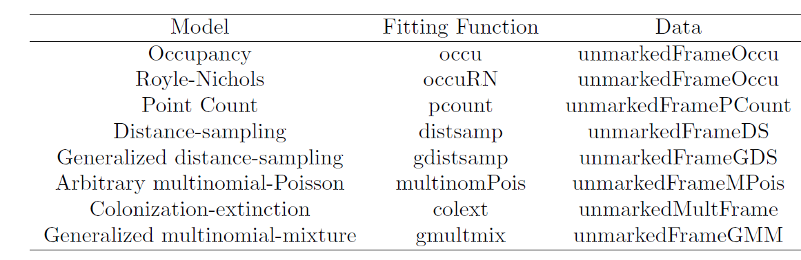
Unmarked hierarchical models

Slide 29
Questions so far?

Slide 30
Follow along example
Rmarkdown file:
“6. Single Season Occupancy Models.docx”

